Slide 1


🔍 Agentic Company Research Agent
Welcome to the future of company intelligence, powered by multi-agent AI.
by Gaurav tailor

Slide 2

😤 Traditional Company Research is Broken
Time Intensive
Hours spent searching multiple sources.
Inconsistent Quality
Information varies wildly in reliability.
Lack of Standardization
No consistent reporting format.
Manual Effort
Doesn't scale with demand.
We need automated, intelligent research solutions now.

Slide 3





🤖 Multi-Agent AI Research Pipeline
Our solution leverages 8 specialized AI Agents working in concert:
Company Analyzer
Extracts core business information.
Industry Analyzer
Identifies market trends and competitive landscape.
Financial Analyst
Evaluates key financial metrics and performance.
News Scanner
Monitors recent developments and media sentiment.
Processing Pipeline
Curation, synthesis, and report generation.
Like having a dedicated team of expert researchers at your fingertips.

Slide 4
🏗️ System Architecture
Seamless Integration
Strategic AI Model Selection
React Frontend ↔ FastAPI Backend ↔ AI Agent Pipeline
Gemini 2.0 Flash: Optimized for high-context synthesis.
↕ ↕ ↕ WebSocket ←→ Real-time Updates ←→ Live Progress
GPT-4.1 Mini: Ideal for precise formatting and structure.
The right tool for the right job, ensuring optimal performance.

Slide 5
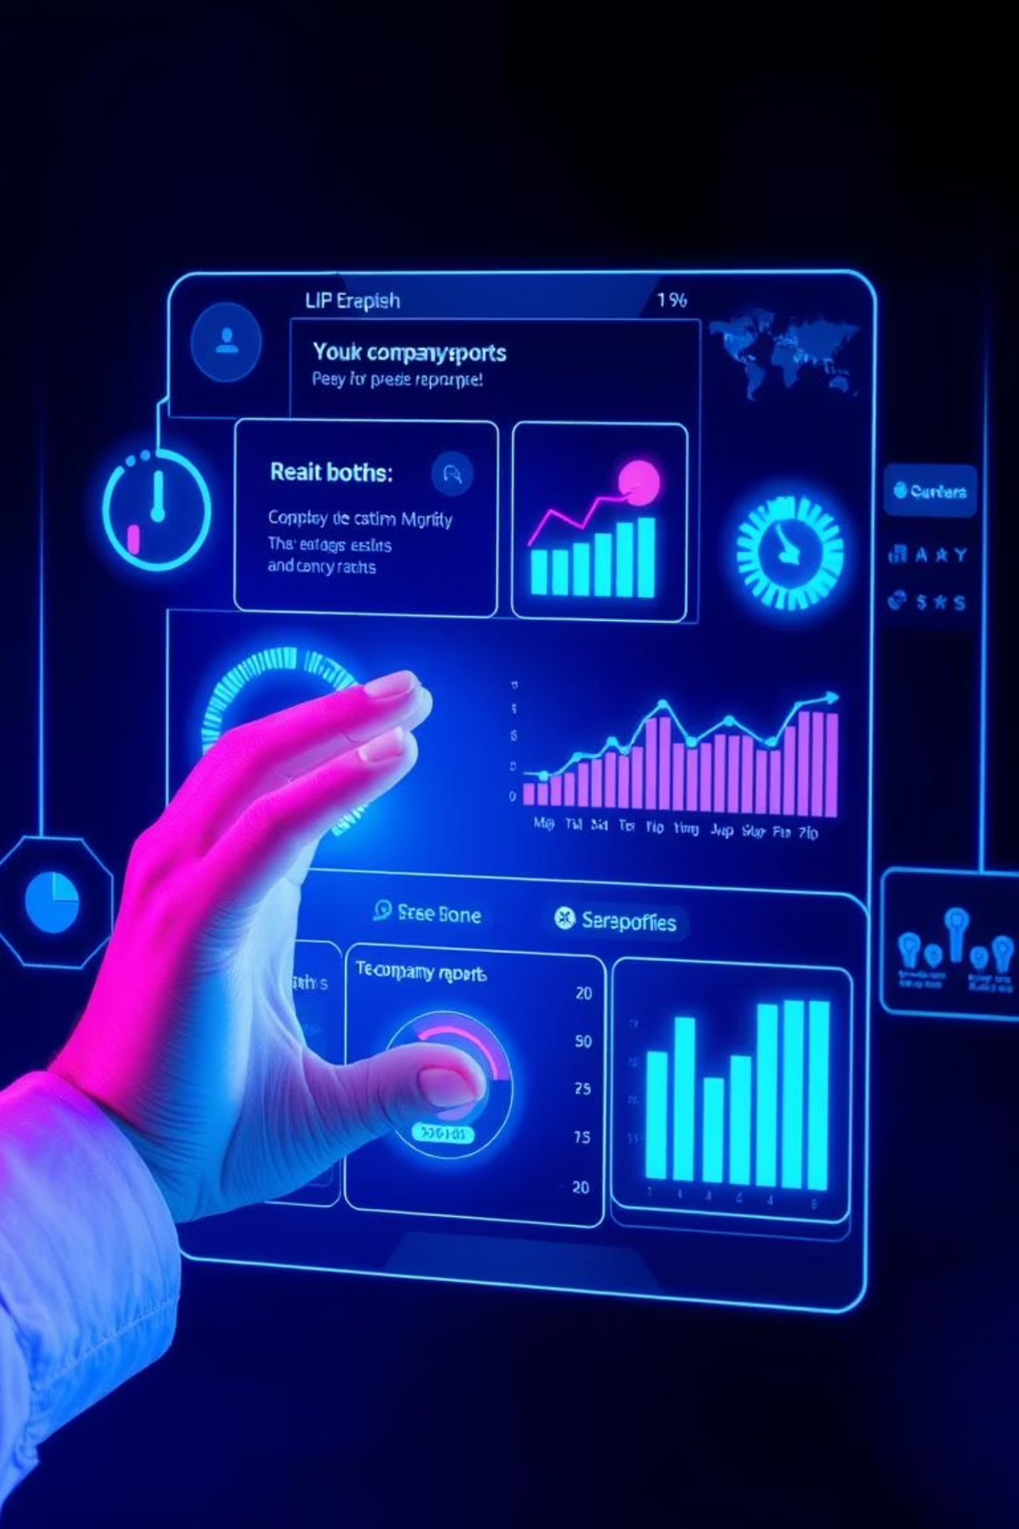

🎬 Live Demonstration
Let's research Tesla in real-time and observe the process:
Input Parameters
Simply provide company name + industry.
Real-Time Progress
Watch as agents work and content is curated live.
Automated Generation
Receive a professional report in under 3 minutes.

Slide 6




🚀 What Makes This Special
Multi-Agent Orchestration
8 specialized agents using LangGraph for parallel processing and state management.
Real-Time Streaming
WebSocket updates for transparent and immediate progress tracking.
AI-Powered Curation
Tavily relevance scoring ensures quality-first content filtering.

Slide 7
📊 Performance Metrics
Speed & Quality
Business Impact
2-3
50-100
10x
—
Minutes per comprehensive report
Sources researched per company
Faster than traditional manual research
Professional quality output guaranteed
—
—
AI-curated for relevance & quality
Scalable to multiple companies and industries

Slide 8
💻 Built with Modern Tech
Backend
Frontend
Deployment
FastAPI + Python for robust API
React + TypeScript for dynamic UI
Production ready and deployed
LangGraph for agent orchestration
Tailwind CSS for efficient styling
Docker containerization for scalability
Gemini 2.0 Flash + GPT-4.1 Mini integration
Framer Motion for smooth animations
WebSockets for real-time updates

Slide 9
🎯 Who Benefits?
Target Users
Value Proposition
Investment Firms
"From hours to minutes with professional quality."
Enhanced due diligence and market analysis.
Our solution revolutionizes how company research is conducted, delivering unprecedented speed and accuracy.
Sales Teams
Rapid prospect research and personalized outreach.
Consultants
Quick client background and industry insights.
Journalists & Students
Streamlined investigation and academic research.

Slide 10


The Future of Company Research is Here
Experience the power of multi-agent AI for automated, intelligent company intelligence.

